Slide 1

Servlets, JSP and JDBC
www.cognixia.com

Slide 2
Servlets Overview
Servlets are protocol- and platform-independent server side components, written in Java, which dynamically extend Java-enabled servers.
They have become more and more popular as they benefit from all the advantages of the Java programming language in particular Architecture and Platform Independence and the ability to build robust and secure applications.

Slide 3
Servlet Overview
A Servlet, in simple terms, is a Java program running under a web server taking a 'request' object as an input and responding back by a 'response' object. Typically a web browser will send the request in HTTP format.
The Servlet container will convert that into a request object. Similarly the response object - populated by the Servlet is converted into an HTTP response by the Servlet container
This mechanism makes the browser - web server interaction very easy
A servlet is a Java class and thus needs to be executed in a Java Virtual Machine by a service called a servlet engine. The servlet engine loads the servlet before it can be used. The servlet then stays loaded until it is unloaded or the servlet engine is shut down.

Slide 4
Servlet Classes
A Servlet, in its most general form, is an instance of a class, which implements the javax.servlet.Servlet interface.
Most Servlets, extend one of the standard implementations of that interface, usually javax.servlet.http.HttpServlet.
HTTP Servlets extend the javax.servlet.http.HttpServlet class

Slide 5
Servlet Lifecycle
A servlet follows a certain life cycle. The servlet life cycle is managed by the servlet container. The life cycle contains the following steps:
Load Servlet Class.
Create Instance of Servlet.
Call the servlets init() method.
Call the servlets service() method.
Call the servlets destroy() method.

Slide 6
Servlet Lifecycle
A servlet follows a certain life cycle. The servlet life cycle is managed by the servlet container. The life cycle contains the following steps:
Load Servlet Class.
Create Instance of Servlet.
Call the servlets init() method.
Call the servlets service() method.
Call the servlets destroy() method.

Slide 7
Servlet Lifecycle
Load Servlet Class
Before a servlet can be invoked the servlet container must first load its class definition. This is done just like any other class is loaded.
Create Instance of Servlet
When the servlet class is loaded, the servlet container creates an instance of the servlet.
Typically, only a single isntance of the servlet is created, and concurrent requests to the servlet are executed on the same servlet instance. This is really up to the servlet container to decide, though. But typically, there is just one instance.
Call the Servlets init() Method
When a servlet instance is created, its init() method is invoked. The init() method allows a servlet to initialize itself before the first request is processed.
You can specify init parameters to the servlet in the web.xml file

Slide 8
Servlet Lifecycle
Call the Servlets service() Method
For every request received to the servlet, the servlets service() method is called. For HttpServlet subclasses, one of the doGet(), doPost() etc. methods are typically called.
As long as the servlet is active in the servlet container, the service() method can be called. Thus, this step in the life cycle can be executed multiple times.
Call the Servlets destroy() Method
When a servlet is unloaded by the servlet container, its destroy() method is called. This step is only executed once, since a servlet is only unloaded once.
A servlet is unloaded by the container if the container shuts down, or if the container reloads the whole web application at runtime.

Slide 9
Servlet Lifecycle
The HttpServlet class reads the HTTP request, and determines if the request is an HTTP GET, POST, PUT, DELETE, HEAD etc. and calls one the corresponding method.
To respond to e.g. HTTP GET requests only, you will extend the HttpServlet class, and override the doGet() method only.

Slide 10
Servlet Sample
package com.collabera.jump;
import java.io.IOException;
import javax.servlet.ServletException;
import javax.servlet.http.HttpServlet;
import javax.servlet.http.HttpServletRequest;
import javax.servlet.http.HttpServletResponse;
public class SimpleServlet extends HttpServlet {
private static final long serialVersionUID = 1L;
protected void doGet(HttpServletRequest request, HttpServletResponse response) throws ServletException, IOException {
response.getWriter().append("Served at: ").append(request.getContextPath());
}
protected void doPost(HttpServletRequest request, HttpServletResponse response) throws ServletException, IOException {
doGet(request, response);
}
}

Slide 11
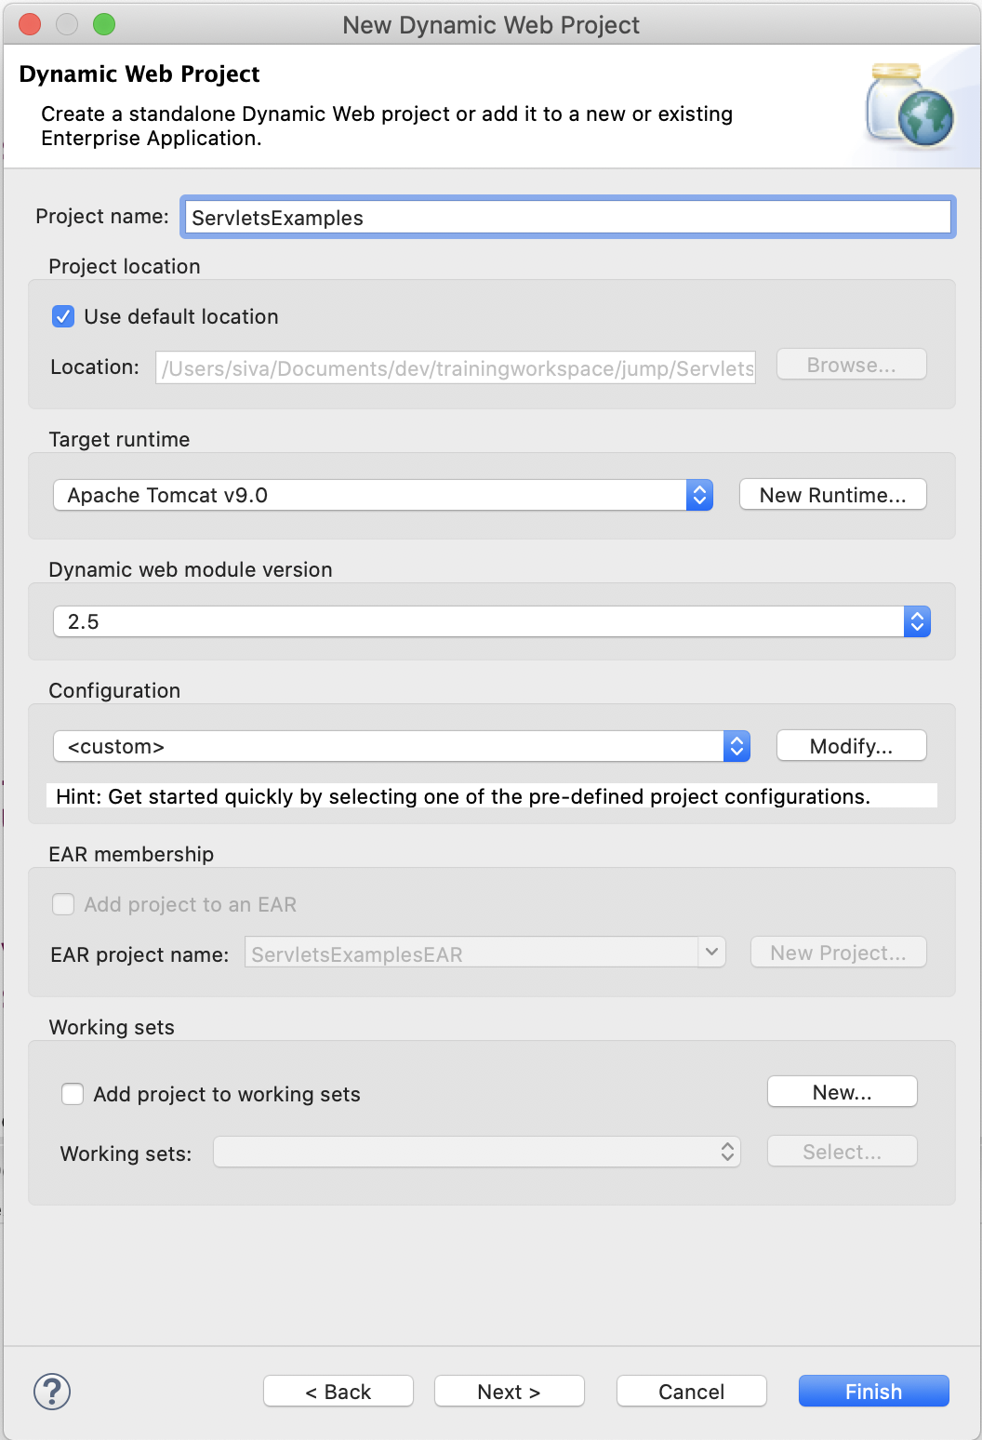
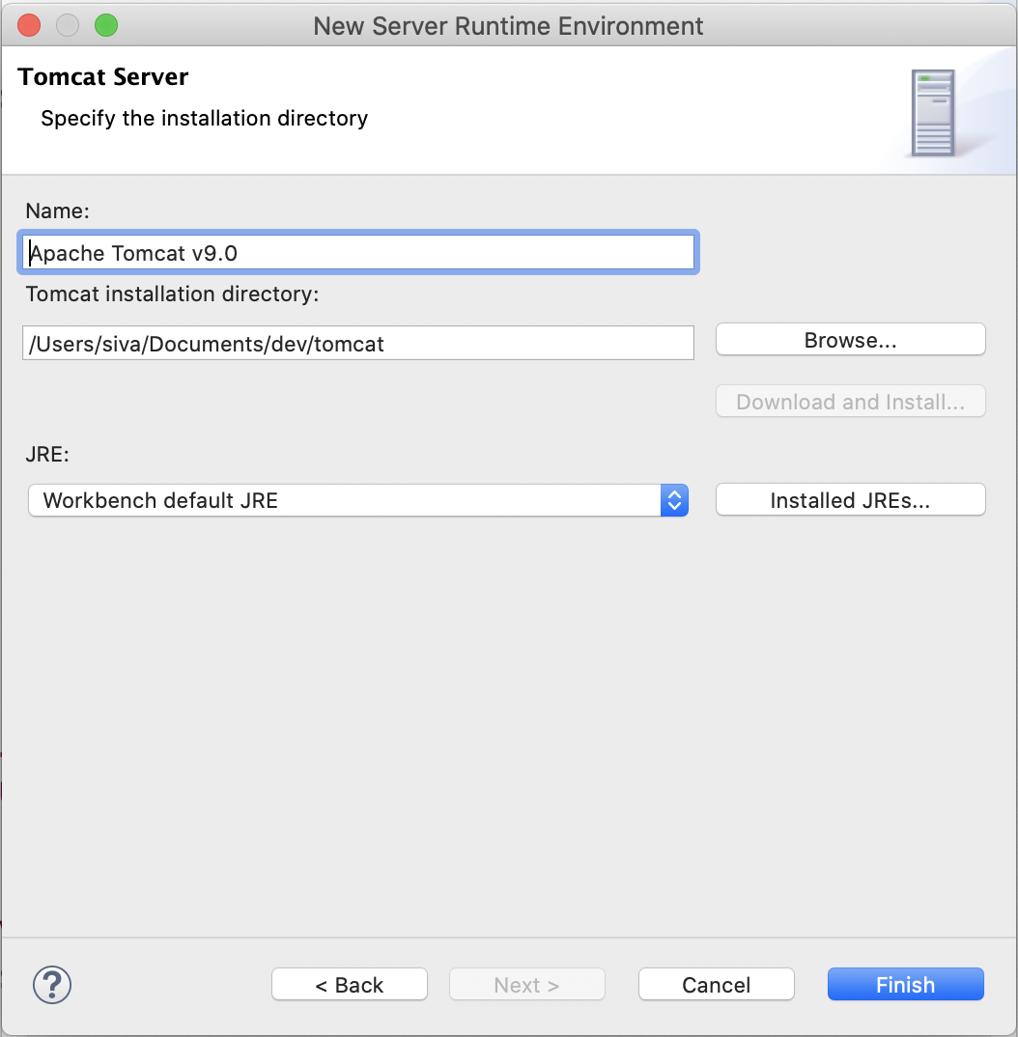
Servlets in Eclipse STS

Slide 12
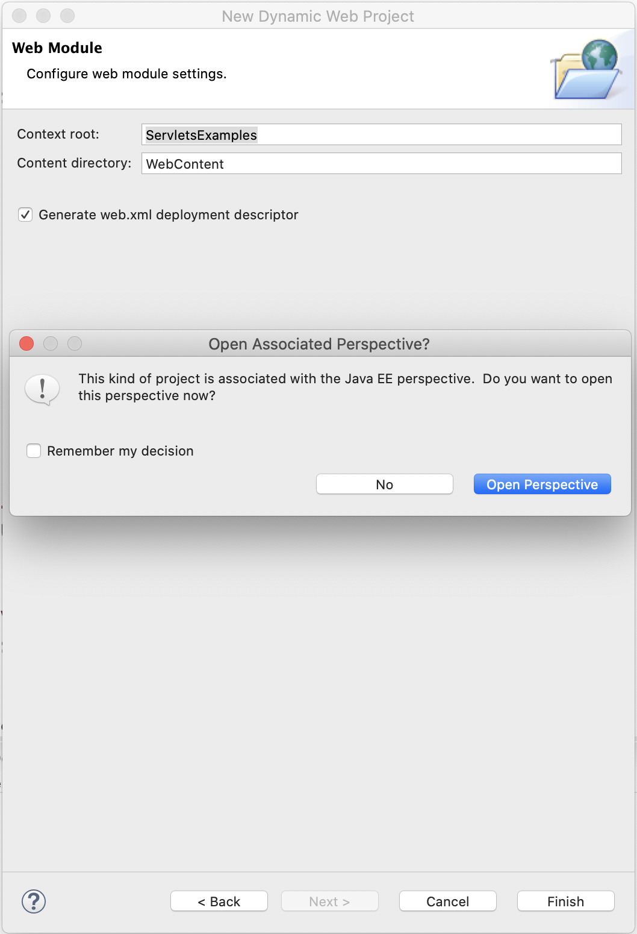
Servlets in Eclipse STS

Slide 13
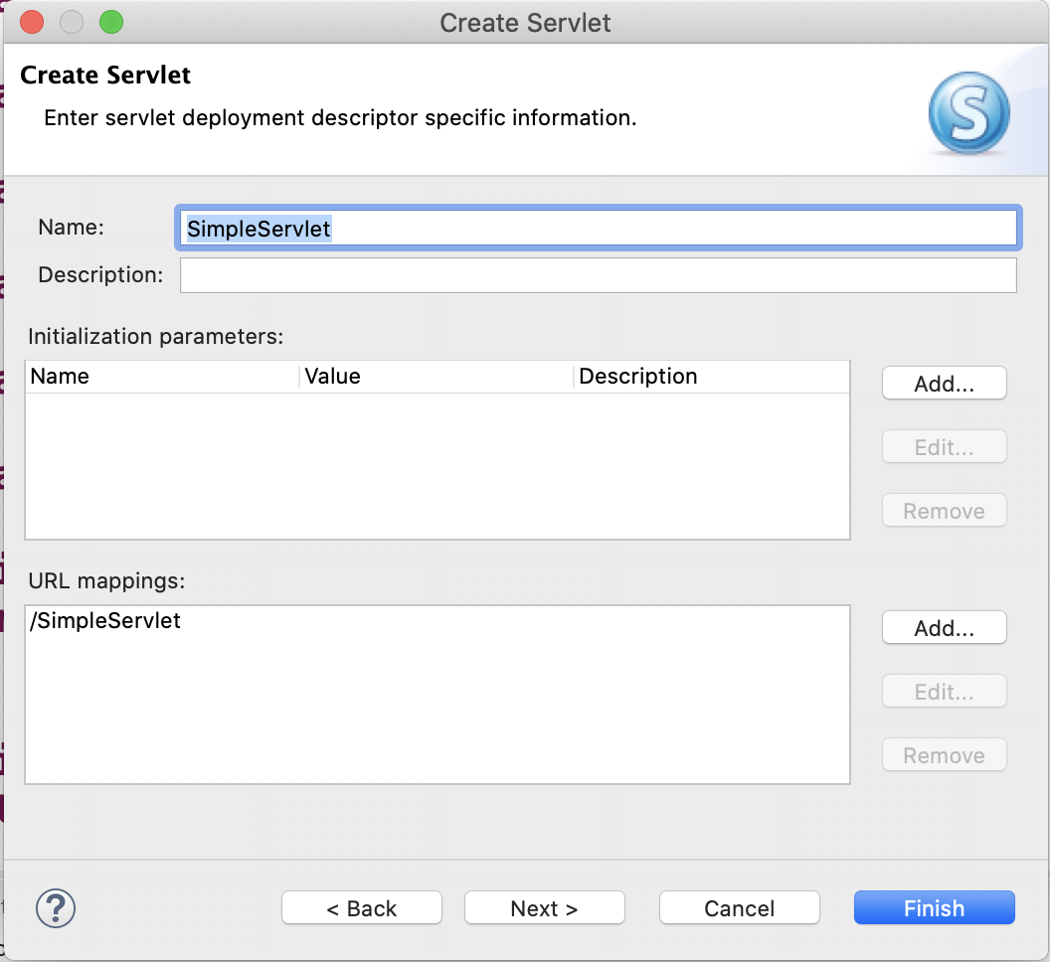
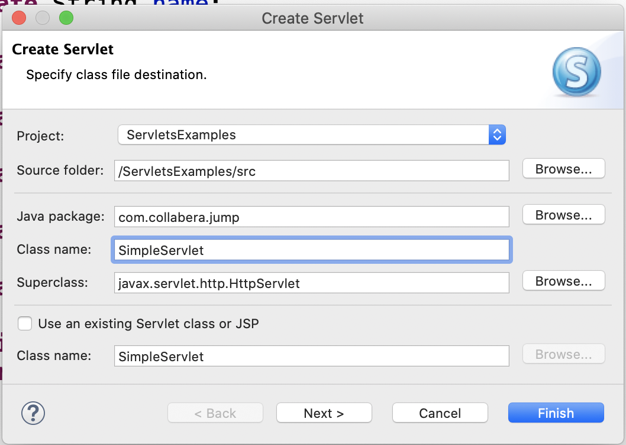
Servlets in Eclipse STS

Slide 14
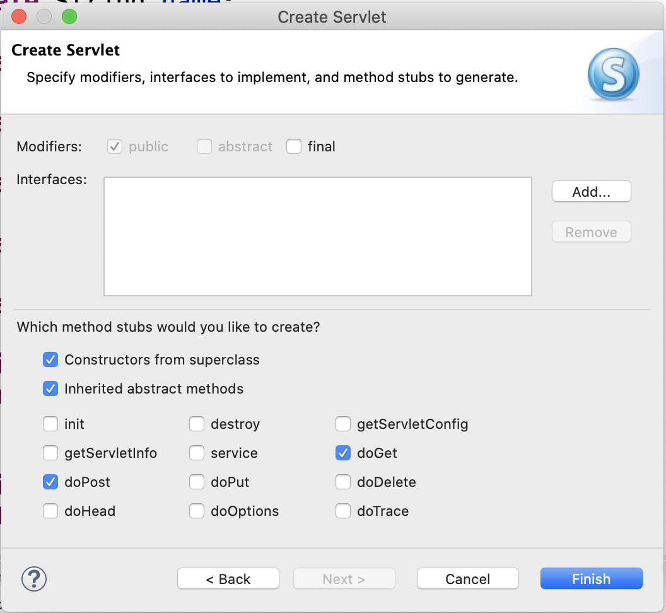
Servlets in Eclipse STS

Slide 15
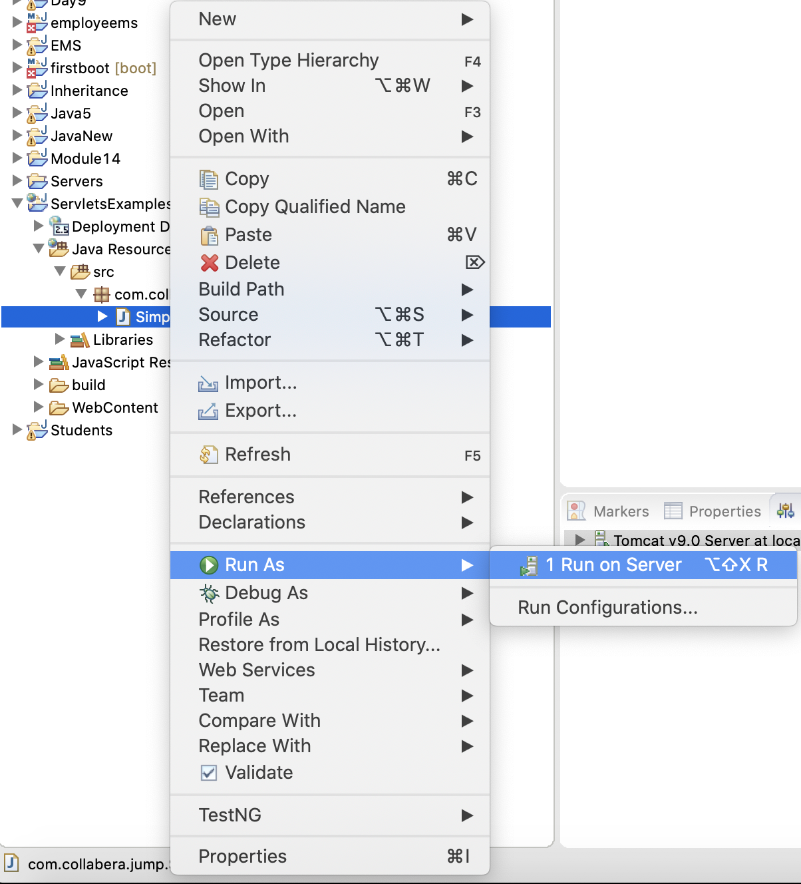
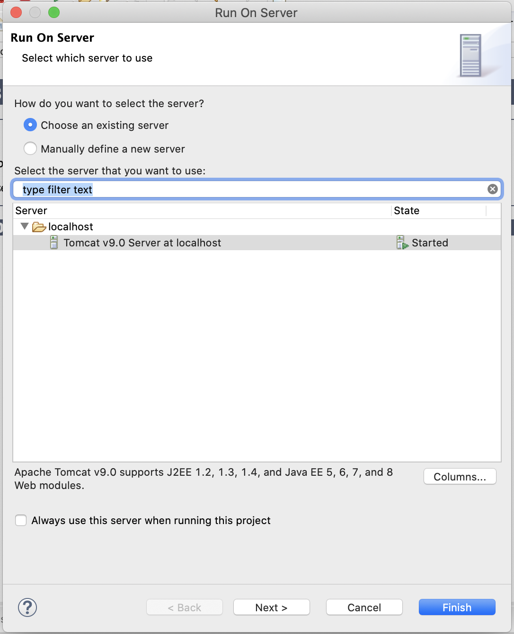
Servlets in Eclipse STS

Slide 16
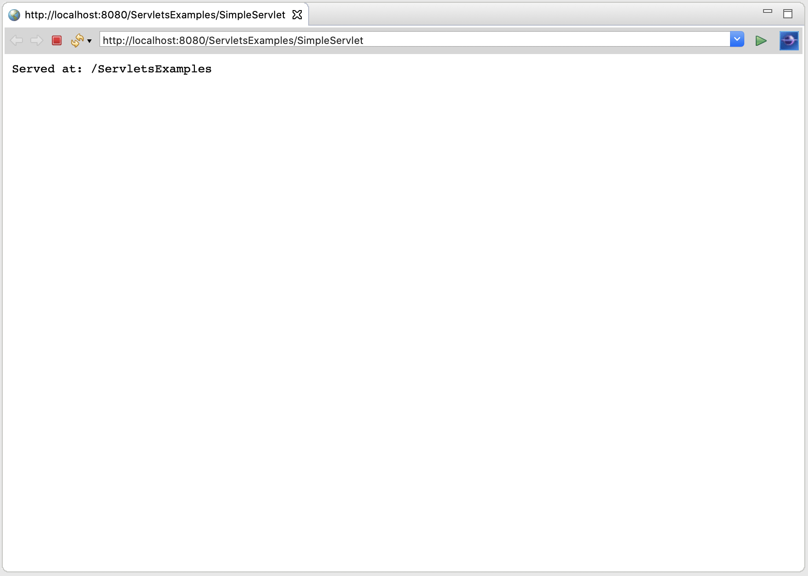
Servlets in Eclipse STS

Slide 17
Servlet Init Method
A Servlet is a Java class that implements the Servlet interface. This interface has three methods that define the Servlet's life cycle:
public void init(ServletConfig config) throws ServletException
This method is called once when the Servlet is loaded into the Servlet engine, before the Servlet is asked to process its first request.

Slide 18
Servlet Service Method
public void service(ServletRequest request, ServletResponse response) throws ServletException, IOException
This method is called to process a request. It can be called zero, one or many times until the servlet is unloaded. Multiple threads (one per request) can execute this method in parallel so it must be thread safe.

Slide 19
Servlet Destroy Method
public void destroy()
This method is called once just before the Servlet is unloaded and taken out of service.
The init method has a ServletConfig attribute. The Servlet can read its initialization arguments through the ServletConfig object. How the initialization arguments are set is Servlet engine dependent but they are usually defined in a configuration file.

Slide 20
Servlet Hello
package com.collabera.jump;
import java.io.IOException;
import java.io.PrintWriter;
import javax.servlet.ServletException;
import javax.servlet.http.HttpServlet;
import javax.servlet.http.HttpServletRequest;
import javax.servlet.http.HttpServletResponse;
public class Hello extends HttpServlet {
private static final long serialVersionUID = 1L;
protected void doGet(HttpServletRequest request, HttpServletResponse response) throws ServletException, IOException {
response.setContentType("text/html");
PrintWriter out = response.getWriter();
out.println("<html>"); out.println("<body>");
out.println("<h1><font color='green'>Hello World!</font></h1>");
out.println("</body>");
out.println("</html>");
out.close();
}
}

Slide 21
Web Description
Lines 2 through 9 - import statements
These are the minimum number of Java packages that need to be imported that are required for a web servlet
Line 8 - servlet class declaration
Class definition for a servlet which extends HttpServlet
Lines 10 - doGet() Override
Overriding the doGet() method
Notice that both a ServletException and IOException must be thrown
Line 11 - Setting the content type
sets the content type for the servlet to send back as a HttpServletResponse
the content type must be set before a ServletOutputStream or PrintWriter are declared
Line 12 - declaring a PrintWriter object
PrintWriter out will be used to write text to a response
Lines 13 through 16 - "out.println"
Writing out the html code as determined by "text/html"
Line 17 - Closing the PrintWriter
Closing a PrintWriter at the end of a method is a standard practice of Java Servlet developers

Slide 22
Hello.java description
WEB-INF\web.xml is the source of the web descriptor which needs to be modified to enable Hello Servlet to function. Build your project first.
This xml file contains a log file for every session to http.
Warning! Do not change the xml files in any other Tomcat directory as this would require you to rebuild or recreate your project.

Slide 23
Web.xml description
These set of instructions enable the tomcat server to recognize Hello servlet.
<servlet-mapping> the path which follows here should be the place where the servlet class is stored please be careful when you compile servlet into a package use the path as
<servlet-mapping>package.”servlet_name”</servlet-mapping>
<servlet>
<description></description>
<display-name>SimpleServlet</display-name>
<servlet-name>SimpleServlet</servlet-name>
<servlet-class>com.collabera.jump.SimpleServlet</servlet-class>
</servlet>
<servlet-mapping>
<servlet-name>SimpleServlet</servlet-name>
<url-pattern>/SimpleServlet</url-pattern>
</servlet-mapping>
<servlet>
<description></description>
<display-name>Hello</display-name>
<servlet-name>Hello</servlet-name>
<servlet-class>com.collabera.jump.Hello</servlet-class>
</servlet>
<servlet-mapping>
<servlet-name>Hello</servlet-name>
<url-pattern>/Hello</url-pattern>
</servlet-mapping>

Slide 24
Java Server Pages
Java Server Pages (JSP) is a technology which is used to develop web pages by inserting Java code into the HTML pages by making special JSP tags. The JSP tags which allow java code to be included into it are <% ----java code----%>.
It can consist of either HTML or XML (combination of both is also possible) with JSP actions and commands.
It can be used as HTML page, which can be used in forms and registration pages with the dynamic content into it.
Dynamic content includes some fields like dropdown, checkboxes, etc. whose value will be fetched from the database.
This can also be used to access JavaBeans objects.
We can share information across pages using request and response objects.
JSP can be used for separation of the view layer with the business logic in the web application.

Slide 25
Java Server Pages Lifecycle
What is JSP LifeCycle?
JSP Life Cycle is defined as translation of JSP Page into servlet as a JSP Page needs to be converted into servlet first in order to process the service requests. The Life Cycle starts with the creation of JSP and ends with the disintegration of that.
When the browser asks for a JSP, JSP engine first checks whether it needs to compile the page. If the JSP is last compiled or the recent modification is done in JSP, then the JSP engine compiles the page.
Compilation process of JSP page involves three steps:
Parsing of JSP
Turning JSP into servlet
Compiling the servlet

Slide 26
Java Server Pages Lifecycle

Slide 27
Index.jsp
<%@ page language="java" contentType="text/html;" pageEncoding="ISO-8859-1"
isELIgnored="false"%>
<%@page import="java.util.Date" %>
<!DOCTYPE html PUBLIC "-//W3C//DTD HTML 4.01 Transitional//EN" "http://www.w3.org/TR/html4/loose.dtd">
<html>
<head>
<meta http-equiv="Content-Type" content="text/html; charset=ISO-8859-1">
<title>Hello Cognixia!</title>
</head>
<body>
<a>Date is:</a>
<%= new java.util.Date() %>
</body>
</html>

Slide 28
demo.jsp
<html>
<head>
<title>Demo JSP</title>
</head>
<%
int demvar=0;%>
<body>
Count is:
<% Out.println(demovar++); %>
<body>
</html>

Slide 29
Java Server Pages Lifecycle
Code Explanation for Demo.jsp
Code Line 1: html start tag
Code Line 2: Head tag
Code Line 3 - 4: Title Tag i.e. Demo JSP and closing head tag
Code Line 5,6: Scriptlet tag wherein initializing the variable demo
Code Line 7 - 8: In body tag, a text to be printed in the output (Count is: )
Code Line 9: Scriplet tag where trying to print the variable demovar with incremented value
Code Line 10-11: Body and HTML tags closed

Slide 30
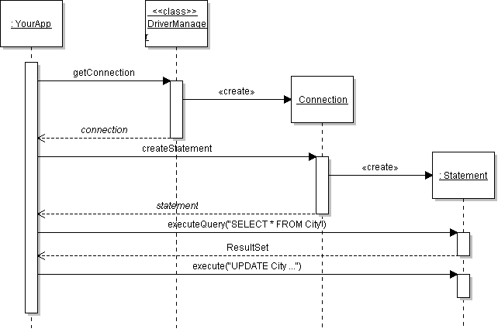
JDBC Overview
selects a specific Connection type and instantiates it
creates Statements for database actions

Slide 31
JDBC Code
/** BAD CODE. We'll fix this later. */
static final String URL = "jdbc:mysql://dbserver/world";
static final String USER = "student";
static final String PASSWORD = "secret";
// 1. Get a Connection to the database.
Connection connection = DriverManager.getConnection( URL, USER, PASSWORD );
// 2. Create a Statement
Statement statement = connection.createStatement();
// 3. Execute the Statement with SQL command.
ResultSet rs = statement.executeQuery("SELECT * FROM ...");
// 4. Use the Result.
while ( rs.next( ) ) {
String name = rs.getString("name");

Slide 32
Connecting to a Database in Java (1)
java.sql.Connection is a standard interface for connecting to any database.
Each database type requires its own jdbc driver that implements this interface.
MySQL driver mysql-connector-java-x-bin.jar
Derby driver: derby.jar or derbyclient.jar
HSQLDB driver: hsqldb.jar
DriverManager selects the driver based on URL.

Slide 33
DriverManager returns a Connection
url = "jdbc:mysql://hostname/database"
DriverManager
getConnection( url, user, passwd) : Connection
<<interface>>
Connection
createStatement(): Statement
close( )
isClosed( ): boolean
getCatalog( ): String
creates
HSQLConnection
MySqlConnection

Slide 34
Where is the Database Driver?
Driver is in a JAR file.
JAR file must be on the CLASSPATH.
Use one of these:
add as an external jar file to your IDE project
add the JAR to your CLASSPATH CLASSPATH = /my/path/mysql-connector.jar;.
add JAR using the Java command line: java -cp /my/path/mysql-connector.jar ...
Put JAR file in the JRE/lib/ext directory: C:/java/jre1.6.0/lib/ext/mysql-connector.jar

Slide 35
Can't find the Driver?
DriverManager finds a registered database driver.
How?
Automatically. This should happen with type 4 & 5.
Load the driver class in your program:
Class.forName("com.mysql.jdbc.Driver");
Add driver to the jdbc.drivers property
System.setProperty("jdbc.drivers",
"com.mysql.jdbc.Driver");
Specify jdbc.drivers property on command line:
java -Djdbc.drivers="com.mysql.jdbc.Driver" ...

Slide 36
Database URL
The format of a database URL is:
String DB_URL = "jdbc:mysql://dbserver:3306/world";
Protocol Sub-protocol Hostname Port DatabaseName
Port is the TCP port number where the database server is listening.
3306 is the default port for MySQL
Use hostname "localhost" for the local machine.

Slide 37
Database URL
The hostname and port are optional.
For MySQL driver: defaults are localhost and port 3306
Example: These 4 URL refer to the same database
"jdbc:mysql://localhost:3306/world"
"jdbc:mysql://localhost/world"
"jdbc:mysql:///world"
"jdbc:mysql:/world"

Slide 38
JDBC Driver
You can get a JDBC driver (network connector) for most databases: MySQL, PostgreSQL, Oracle, SQLite ...
5 Types of JDBC drivers
Type 1: JDBC-to-ODBC bridge driver for Microsoft ODBC. Java JDBC includes the bridge driver: sun.jdbc.odbc.JdbcOdbcDriver.
Type 2: Native-API driver (written in C or C++ using JNI)
Type 3: Pure Java client-to-server driver, use a standard network protocol. The server translates requests to server-specific protocol.
Type 4: Pure Java drivers implementing a database-specific network protocol. Java programs can connect directly to the database.
Type 5: The latest.

Slide 39
Exercise: Install JDBC Driver
Download the mysql-connector-*.jar file
http://www.mysql.com
Install it in your software "library" directory, e.g. C:/lib/mysql
JDBC Connector for MySQL:
mysql-connector-java-5.x.y.zip

Slide 40
Executing SQL Commands
To execute an SQL command, use the Connection object to create an SQL Statement object.
Statement interface defines methods for executing commands.
Statement statement =
connection.createStatement( );
// execute an UPDATE command
int count = statement.executeUpdate( "UPDATE City
SET population=30000 WHERE name='Bangsaen'" );
System.out.println(
"Modified " + count + " records");

Slide 41
Executing SQL Queries
A statement.executeQuery( ) returns a ResultSet.
ResultSet is a scrollable set of values.
Statement statement = connection.createStatement();
// execute a SELECT command
ResultSet rs = statement.executeQuery(
"SELECT * FROM city WHERE id = "+id );
rs.first(); // scroll to first result
do {
String name = rs.getString(1);// get 1st field
int population = rs.getInt("population");
...
} while( rs.next() );

Slide 42
Search for a City
Scanner console = new Scanner(System.in);
System.out.print( "Name of city to find? " );
String name = console.nextLine().trim();
// This is not safe...
String query =
"SELECT * FROM city WHERE Name='" +name+ "'";
ResultSet rs = statement.executeQuery( query );
Use a statement you already created.

Slide 43
ResultSet Methods
ResultSet contains one "row" for each result returned from the query.
ResultSet contains get methods for column data:
"get" by column number -- starts at 1 (not 0)!
"get" by column name -- field names in table/query.
String query = "SELECT * FROM Country WHERE ...";
ResultSet rs = statement.executeQuery( query );
// go to first row of results
rs.first( );
// display the values
System.out.println( rs.getString( 1 ) );
System.out.println( rs.getInt( "population" ) );
get by column number
get by name

Slide 44
ResultSet Methods
A ResultSet contains one "row" for each result returned from the query. Indices start from 1 (not 0)!
ResultSet
next() : boolean
previous() : boolean
first() : boolean
last() : boolean
absolute( k )
getInt( name: String )
getInt( index: int )
...
go to next row of results. "false" if no more.
go to previous row. "false" if 1st result.
go to first row of results.
go to last row of results.
go to k-th row of results.
get int value of field "name"
get int value of k-th column in a record

Slide 45
ResultSet lets you access the results one-by-one without knowing how the results are organized.
ResultSet rs = statement.executeQuery( "..." );
while ( rs.next( ) ) {
String name = rs.getString("name");
int population = rs.getInt("popuation");
System.out.println( name +" "+population );
}

Slide 46
ResultSet Methods for Getting Data
ResultSet "get" methods return column data:
getLong( 3 ) : get by column index (most efficient)
getLong( "population" ) : get by field name (safest)
getInt( ), getLong( ) - get Integer field value
getFloat( ), getDouble() - get floating pt. value
getString( ) - get Char or Varchar field value
getDate( ) - get Date or Timestamp field value
getBoolean( ) - get a Bit field value
getBytes( ) - get Binary data
getBigDecimal( ) - get Decimal field as BigDecimal
getBlob( ) - get Binary Large Object
getObject( ) - get any field value

Slide 47
ResultSet and Type Compatibility
SQL data types don't exactly match Java data types.
See Java API and JDBC tutorial for conversion rules.
int pop1 = rs.getInt( "population" );
long pop2 = rs.getLong( "population" );
// float - int conversion is possible, too
float area = rs.getFloat( "surfacearea" );
// convert char(n) to String
String region = rs.getString( "region" );
For all compatibilities, see: /tutorial/jdbc/basics/retrieving.html

Slide 48
How to Execute SQL Commands
The Statement interface defines many execute methods:
Resultset rs = statement.executeQuery("SELECT ...");
use for statements that return data values (SELECT)
int count = statement.executeUpdate("UPDATE ...");
use for INSERT, UPDATE, and DELETE
boolean b = statement.execute("DROP TABLE test");
use to execute any SQL statement(s)

Slide 49
Security Problem
Scanner scanner = new Scanner( System.in );
System.out.print( "Name of city to find? ");
String name = scanner.nextLine( );
String query = String.format(
"SELECT * FROM city WHERE name=‘%s’”, name );
ResultSet rs = statement.executeQuery( query );

Slide 50
Security Problem (2)
String name = "Bangkok";
String query = String.format(
"SELECT * FROM city WHERE name='%s'",
name );
Becomes:
query="SELECT * FROM city WHERE name='Bangkok' "
ResultSet rs = statement.executeQuery( query );

Slide 51
Hack The Code
Name of City to Find? x' OR 'a'='a
String query = String.format(
"SELECT * FROM City WHERE name='%s'"
, name);
"SELECT * FROM City
WHERE name='x' OR 'a'='a'"

Slide 52
SQL Injection
City to find? Bangkok'; DELETE FROM city WHERE 'x'='x
String query = String.format(
"SELECT * FROM city WHERE name='%s' ",
name );
Becomes:
"SELECT * FROM city WHERE name='Bangkok' ; DELETE FROM city WHERE 'x'='x' "
ResultSet rs = statement.executeQuery( query );

Slide 53
Using a PreparedStatement
PreparedStatement uses placeholders for data values.
PreparedStatement pstmt = connection.prepareStatement(
"SELECT * FROM Country where name = ?" );
// get data for Thailand
pstmt.setString( 1, "Thailand");
ResultSet rs = pstmt.executeQuery( );
saveResultSetAsObject( rs, country1 );
PreparedStatement will quote the string for you. Don't use '?'
Substitute "Thailand" for placeholder #1

Slide 54
Reuse a PreparedStatement
You can reuse a PreparedStatement with new data.
// get data for Laos
pstmt.setString( 1, "Laos");
rs = pstmt.executeQuery( );
saveResultSetAsObject( rs, country2 );
Substitute "Laos" for placeholder #1

Slide 55
Create a Class to Manage DB Connection
Create ConnectionManager with a static factory method
ConnectionManager
- connection : Connection
+getConnection( ) : Connection
+close( ) : void
// example how to use
Statement statement =
ConnectionManager.getConnection().createStatement( );

Slide 56
Simple version of manager (1)
public class ConnectionManager {
// literal constants in Java code is bad code.
// we will change to a configuration file later.
private static String driver = "com.mysql.jdbc.Driver";
private static String url = "jdbc:mysql://hostname/world";
private static String user = "student";
private static String password = "student";
/* a single shared database connection */
private static Connection connection = null;
private ConnectionManager() { /* no object creation */ }

Slide 57
Simple version of ConnectionManager (2)
/* the public accessor uses lazy instantiation */
public static Connection getConnection( ) throws ... {
if ( connection == null ) connection = makeConnection();
return connection;
}

Slide 58
Simple version of ConnectionManager (2)
private static Connection makeConnection( )
throws SQLException {
try {
Class.forName( driver );
// load the database driver class
connection = DriverManager.getConnection(
url, user, password );
} catch ( FileNotFoundException ex ) {
logger.error("connection error", ex ); // Logging
throw new SQLException( ex );
}
}
/* the public accessor uses lazy instantiation */
public static Connection getConnection( ) throws ... {
if ( connection == null ) connection = makeConnection();
return connection;
}

Slide 59
Simple version of ConnectionManager (3)
Catch, Log, and rethrow any exception.
Necessary to avoid Exceptions in app.
Translate low-level exception into higher layer exception
What is a DataAccessException?
translate checked exceptions into unchecked exception to simplify code.
public class DataAccessException extends RuntimeException
{
public DataAccessException(String arg) {
super(arg);
}
}

Slide 60
ConnectionManager using Properties
private static Connection makeConnection( ) throws ... {
Properties props = PropertyManager.getProperties( );
String url = props.getProperty("jdbc.url");
// load the database driver class
connection = DriverManager.getConnection(url, props);
}
Give All the properties to DriverManager.
DriverManager uses jdbc.drivers to locate the JDBC Driver class!
No "ClassNotFoundException"

Slide 61
ConnectionManager Using Properties
public class ConnectionManager {
// literal constants in Java code is baaad.
// we will change to a configuration file later.
private static String url = "jdbc:mysql://hostname/world";
private static String user = "student";
private static String password = "student";
DELETE THIS

Slide 62
How to do Object Persistence
Choices for How to do Object Persistence?
write your own DAO using JDBC
Use an Object-Relational Mapping (ORM) Framework
Hibernate, TopLink, MyBatis, Apache Cayenne
Use a Standard Persistence API.
Java Persistence Architecture (JPA)
standard used in JavaEE
implemented by EclipseLink, Hibernate, OpenJPA
Java Data Objects (JD)
implemented by DataNucleus.org
"standard" means you can change the implementation without changing your code

Slide 63
The World Application
Insert class diagram or ER diagram

Slide 64
CityDao for World Application
The primary key is an integer city ID.
Search by name is used in our application, so I add a method for it.
CityDao
find( id: Integer ): City
findByName( name: String ): City[*]
find( query: String ) : City[*]
save( Country ) : boolean
delete( Country ) : boolean

Slide 65
CityDao using JDBC (1)
public class CityDao {
private static final Logger logger = ...; // log4J
private static final CountryDao countryDao;
private static HashMap<Integer,City> cache = ...;
/** retrieve a city by its id */
public City findById( Integer id ) {
if ( cache.containsKey(id) ) return cache.get(id);
List<City> list = find("WHERE id = "+id);
return list.get(0);
}
/** retrieve a city by name */
public List<City> findByName( String name ) {
name = sanitize( name );
List<City> list = find("WHERE name = '"+name+"'");
return list;
}

Slide 66
CityDao using JDBC (2)
/** find cities using a general query, use a
* WHERE ..., HAVING ..., or other selection clause */
public List<City> find( String query ) {
List<City> list = new ArrayList<City>( );
Statement stmt = ConnectionManager
.getConnection( ).createStatement();
String sqlquery = "SELECT * FROM city c " + query;
try {
logger.debug("executing query: " + sqlquery );
ResultSet rs = stmt .executeQuery( sqlquery );
while ( rs.next() ) {
City c = resultSetToCity( rs );
list.add( c );
}
} catch ( SQLException sqle ) {
logger.error( "error executing: "+sqlquery, sqle);
} finally {
if (stmt!=null) try { stmt.close(); }
catch(SQLException e) { /* ignore it */ }
return list;
}

Slide 67
CityDao using JDBC (3)
/** convert a ResultSet entry to a City object */
private City resultSetToCity(ResultSet rs)
throws SQLException {
City city = null;
Integer id = rs.getInt("id");
// is this city already in cache? if so, use it
if ( cache.contains(id) ) city = cache.get(id);
else city = new City();
city.setId(id);
city.setName( rs.getString("Name") );
city.setDistrict( rs.getString("District") );
city.setPopulation( rs.getInt("Population") );
String countrycode = rs.getString("countrycode");

Slide 68
CityDao using JDBC (4)
// add this city to the cache
if ( ! cache.containsKey(id) ) cache.put(id, city);
// now get reference to the country this city refers
logger.info("get country for city "+city.getName() );
Country country = countryDao.findById( countrycode );
city.setCountry( country );
return city;
}

Slide 69
Why CityDao Needs a Cache
What if the application requests cityDao.find("Bangkok")
two times?
We should return the same object each time.
Necessary to avoid infinite loops:
cityDao uses JDBC and gets data for Bangkok
the countrycode for Bangkok is "THA". cityDao must convert this to a country object reference.
cityDao calls countryDao.findById( "THA" )
countryDao finds Thailand, and the capital city has a cityID = 3320. It must convert this to a city reference.
countryDao calls cityDao.findById( 3320 )
cityDao uses JDBC and gets data for Bangkok again
repeat step 2.

Slide 70
CityDao: delete
public boolean delete( City city ) {
if ( city == null || city.getId() == null ) return false;
Long id = city.getId( );
Statement statement = ConnectionManager.getStatement( );
int count = 0;
if ( statement == null ) return false;
String query = "DELETE FROM city WHERE id=" + id;
try {
count = statement.executeUpdate( query );
} catch ( SQLException sqle ) {
logger.error( "error executing: "+query, sqle );
} finally {
ConnectionManager.closeStatement( statement );
}
// is city in the cache?
if ( cache.containsKey(id) ) cache.remove( id );
return count > 0;
}

Slide 71
CityDao: save and update
We can use save( ) for both saving a new object and updating an existing object.
public boolean save( City city ) {
Long id = city.getId( );
if ( id == null ) this is a new city, save it ;
else {
if ( cache.containsKey( id ) )
this city is already in database, update it
else
this city is not in the database, save it
but check that no other city has this id
}

Slide 72
UI
/** prompt for a city name and display city info */
private void citySearch( ) {
out.print("Input name of city: ");
String name = in.next().trim();
// run the query
City city = cityDao.findByName( name );
if ( city == null ) {
out.println("Sorry, no match or query error");
}
else {
out.println("Name: "+city.getName( ) );
out.println("District: "+city.getDistrict( ) );
out.println("Country: "
+city.getCountry( ).getName( ) );
...
}
}

Slide 73
UI search for country
private void countrySearch() {
out.print("Input name of country: ");
String name = in.next().trim();
// perform the query
List<Country> results = countyDao.findByName( name );
if ( results == null ) ... // failed
for( Country country : results ) {
out.printf("Name: %s\n", country.getName() );
out.printf("Capital: %s\n", country.getCapital() );
out.printf("Region: %s\n", country.getRegion() );

Slide 74
Use a Configuration File
Purpose:
Configuration data such as database URL, username, password, should be in a file not in the Java code.
Put this data in a configuration file.
Example: world.config
# World database properties
jdbc.url=jdbc:mysql://localhost/world
user=student
password=secret
jdbc.drivers=com.mysql.jdbc.Driver

Slide 75
Loading Properties
The java.util.Properties class can read or write "properties" files in this format. (can also write XML).
// get name of the configuration file
String config = "world.config";
// allow user to change this: java -dworld.config=...
config = System.getProperty("world.config", config );
// load the properties
Properties properties = new Properties( );
try {
FileInputStream fis = new FileInputStream( config );
properties.load( fis );
fis.close( );
} catch ( FileNotFoundException e ) { ... }

Slide 76
Use Properties in ConnectionManager
public class ConnectionManager {
private void makeConnection( ) {
Properties properties =
PropertyManager.getProperties();
String jdbc_driver =
properties.getProperty("jdbc.drivers");
String url = properties.getProperty("jdbc.url");
// pass all remaining properties to DriverManager
// including user and password properties
try {
class.forName( jdbc_driver );
connection =
DriverManager.getConnection(url,properties);
} catch ( SQLException sqle ) {
log exception and rethrow as DataAccessException
} catch ( FileNotFoundException e ) {
...

Slide 77
Properties Filename is a property, too
Use a System property to get configuration file name.
// get name of the configuration file
String configfile = System.getProperty( "world.config" );
if ( configfile == null )
configfile = DEFAULT_CONFIG_FILE;
This enables user to change the filename at runtime:
C> java -Dworld.config=c:/temp/config.txt world.jar

Slide 78
java.util.Properties (a HashTable)
Properties p = new Properties( )
create new java.util.Properties object
String value = p.getProperty( name )
get a named property; returns null if not found.
String value =
p.getProperty( name, default_value )
get a property, returns default_value if not found.

Slide 79
System Properties
String value = System.getProperty( name )
get a system property
Properties p = System.getProperties( )
get all the system properties

Slide 80
Details of Statement and ResultSet

Slide 81
Understanding statement objects
A Statement object is tied to a Connection.
Use an re-use a statement object for many database commands.
If the Connection is closed, the statement object is invalid (disconnected).
Statement object consumes resources
close it when you are finished
Statement statement = connection.createStatement();
statement.executeQuery( "SELECT * FROM ... " );
...
statement.close( );

Slide 82
Understanding ResultSet
ResultSet is tied to a statement and a database connection.
if statement or connection is closed, results are gone
if another command is executed, results are gone
ResultSet can change (!) after performing the query
ResultSet can update a database
Statement stmt = connection.createStatement( ResultSet.TYPE_SCROLL_SENSITIVE,
ResultSet.CONCUR_UPDATABLE );
ResultSet rs = statement.executeQuery( query );

Slide 83
Using ResultSet to update a database
Specify ResultSet.CONCUR_UPDATABLE when creating Statement.
Requires (a) support by database driver, (b) UPDATE privilege on tables
// rs is scrollable, will not show changes made
// by others, and will be updatable
Statement statement = connection.createStatement( ResultSet.TYPE_SCROLL_INSENSITIVE,
ResultSet.CONCUR_UPDATABLE );
ResultSet rs = statement.executeQuery( query );
rs.next();
int population = rs.getInt("population");
// add 10,000 to the population
rs.updateInt( "population", population+10000 );
rs.updateRow( );

Slide 84
RowSet
RowSet is like ResultSet, but...
data not tied to database connection.
can be cached.
can be updated by re-connecting to database
can store other kinds of data, such as from file or spreadsheet
<<interface>>
ResultSet
<<interface>>
RowSet
<<interface>>
CachedRowSet
<<interface>>
WebRowSet

Slide 85
RowSet Question
Suppose part of your application is expecting a ResultSet, but you change the lower layers to return a RowSet instead.
Do the upper layers of the application need to change?
<<interface>>
ResultSet
<<interface>>
RowSet
<<interface>>
CachedRowSet
<<interface>>
WebRowSet

Slide 86
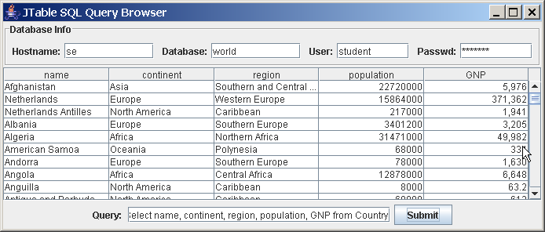
JTable
Swing object looks like a spreadsheet table.
A JTable

Slide 87
Design a TableModel for Queries
Design a TableModel to manage a ResultSet
AbstractTableModel
getColumnCount( ) : int
getColumnName( index ) : String
getColumnClass( index ) : Class
getRowCount( ) : int
getValueAt( row, col ) : Object
JTable
ResultSetTableModel
ResultSetTableModel(statement)
runQuery( query : String )

Slide 88
Implementing TableModel
ResultSet contains some of the data we need.
class ResultSetTableModel {
private Statement statement;
private ResultSet rs;
public Object getValueAt(int row, int col) {
if ( rs == null ) return null;
rs.absolute( row + 1 );
rs.getObject( col );
}
public int getRowCount() {
if ( rs == null ) return 0;
rs.last(); // move to last row
rowCount = rs.getRow();
return rowCount;
}

Slide 89
Implementing TableModel (2)
ResultSet is missing some information.
public int getColumnCount( ) {
}
public String getColumnName( int col ) {
}

Slide 90
ResultSet Meta-data
ResultSet has a getMetaData( ) method that returns a ResultSetMetaData object.
ResultSetMetaData describes the ResultSet.
try {
ResultSet resultSet = statement.executeQuery( query );
ResultSetMetaData metadata = resultSet.getMetaData();
int numberOfColumns = metadata.getColumnCount();
for(int col=1; col<=numberOfColumns; col++) {
// get name and SQL datatype for each column
String name = metadata.getColumnName( col );
int type = metadata.getColumnType( col );
int typeName = metadata.getColumnTypeName( col );
} catch( SQLException sqle ) { ... }

Slide 91
Closing the Connection
It is advisable to close Connection object when done. This frees resources and ensures data integrity.
Connection connection = DriverManager.getConnection(...);
/* use the database */
...
/* done using database */
public void close( ) {
if ( connection == null ) return;
try {
connection.close();
}
catch ( SQLException sqle ) { /* ignore it */ }
finally { connection = null; }
}

Slide 92
Connection Sharing
A database connection consumes resources.
All instances can share the same Connection object.
To enforce this use the Singleton Pattern:
use a factory method to get connection
the method always returns the same instance of the connection

Slide 93
Summary
JDBC specifies standard interfaces for communicating with different databases.
To use JDBC you need a JDBC or ODBC driver for the database.
The application must load a database-specific driver. DriverManager will choose driver when creating a Connection.
a Connection object manages the connection to a database.
a Statement object is used to submit database statements and get results.
A query returns a ResultSet containing data and meta-data.
A ResultSet can be read-only or updateable depending on the Statement object (specified in Statement constructor).
properly close a Statement or Connection when finished to release resources and ensure data integrity.

Slide 94
Important Design Concepts
JDBC specifies standard interfaces for databases. Any database can use JDBC by writing classes that implement these interfaces.
To re-use a connection in different classes, use the Singleton Pattern and a Factory Method for getting the connection object.
Use a finally clause on try - catch blocks to ensure that some code is always executed. Inside the try - catch, you must not use 'return' since this would bypass the "finally" clause. Use 'break'.

Slide 95


